Slide 1
Machine Learning I 60629A
Week #1

Slide 2
Today
Introduction to machine learning
The course (syllabus)
Math review (probability + linear algebra)

Slide 3
Machine Learning (ML)
Science that studies statistical and computational aspects of modeling data for predictive purposes
(Mostly) Empirical science

Slide 4
Data
ML
Predictions
Task: Predict whether an image contains a malignant tumor
Task: Predict the next movie a person should watch

Slide 5

Laurent Charlin — 60629
https://xkcd.com/1838/

Slide 6
“Data analysis, machine learning and data mining are various names given to the practice of statistical inference, depending on the context.”
Probability
Data generating process
Observed data
Inference
–Larry Wasserman in “All of Statistics: A Concise Course in Statistical Inference.”

Slide 7
What is the goal of ML?

Slide 8
A bit of historical context
When I started my PhD very few in ML talked about AI
Recent ML makes progress toward “AI tasks”
Examples of AI tasks: translation, object recognition
In that context: create a machine with human-like capacities? Or a machine that can help humans?

Slide 9
My (imperfect) view:
Understand data through predictive models Understand the world through predictive models

Slide 10
How does ML relate to other fields

Slide 11
Historical View
(Modern) Statistics: ~1900
Machine Learning and Data Mining: ~1960
Data Science: ~2000
11

Slide 12
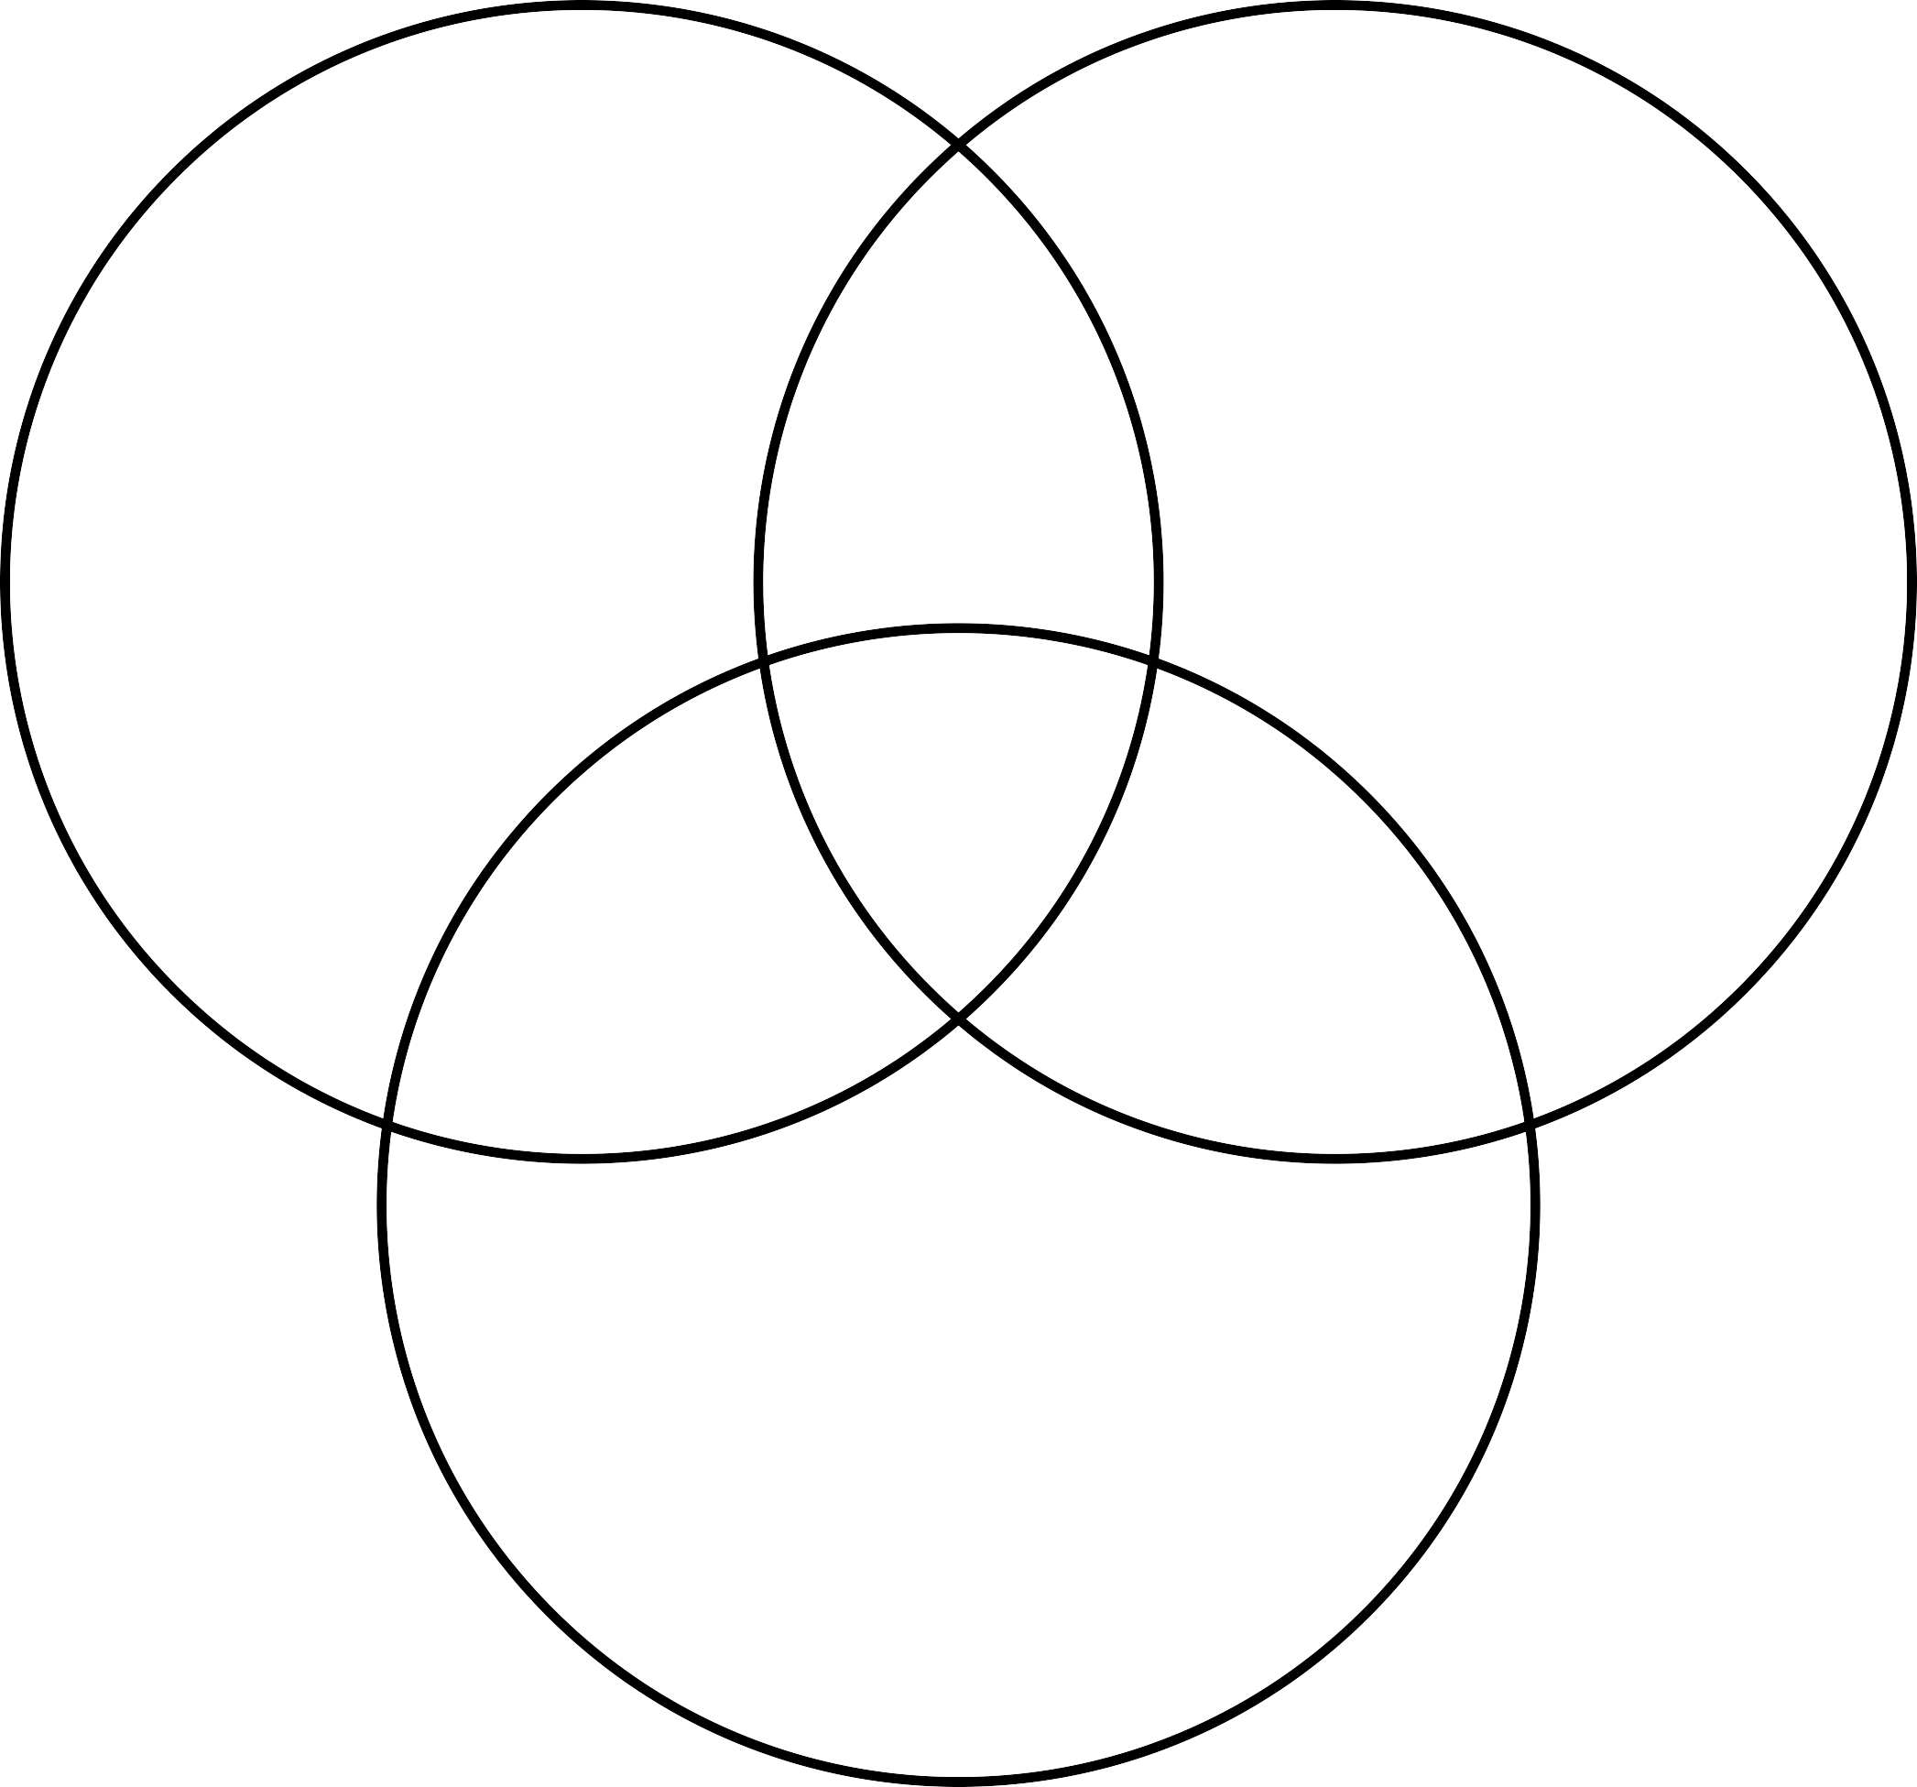
Computer Science
+
Engineering
Machine Learning
Statistics
+
Mathematics
Data Science (BI)
Danger Zone
Traditional Research
Substantive Expertise
12
[Inspired by Drew Conway]

Slide 13
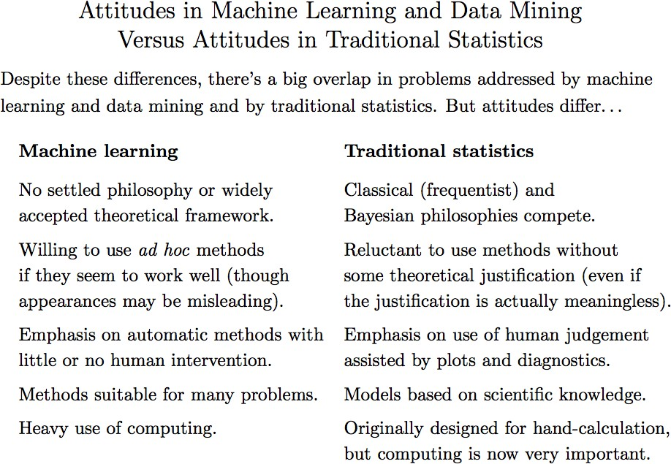
Laurent Charlin — 60629
[Reproduced from R. Neal: http://www.utstat.utoronto.ca/~radford/sta414.S14/week1.pdf ]

Slide 14

Artificial Intelligence
Machine Learning
Deep Learning

Slide 15
Applications of ML
15

Slide 16
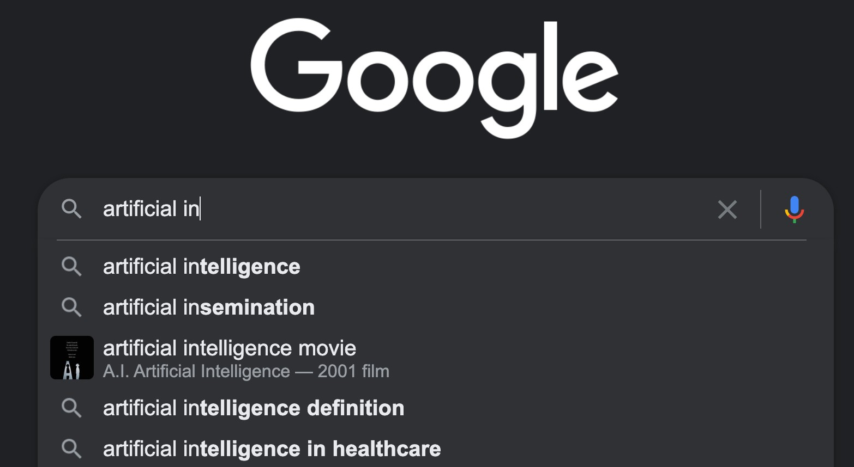

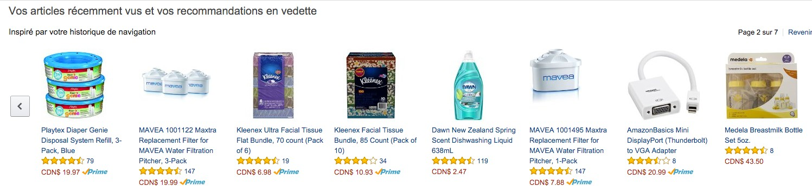

Slide 17
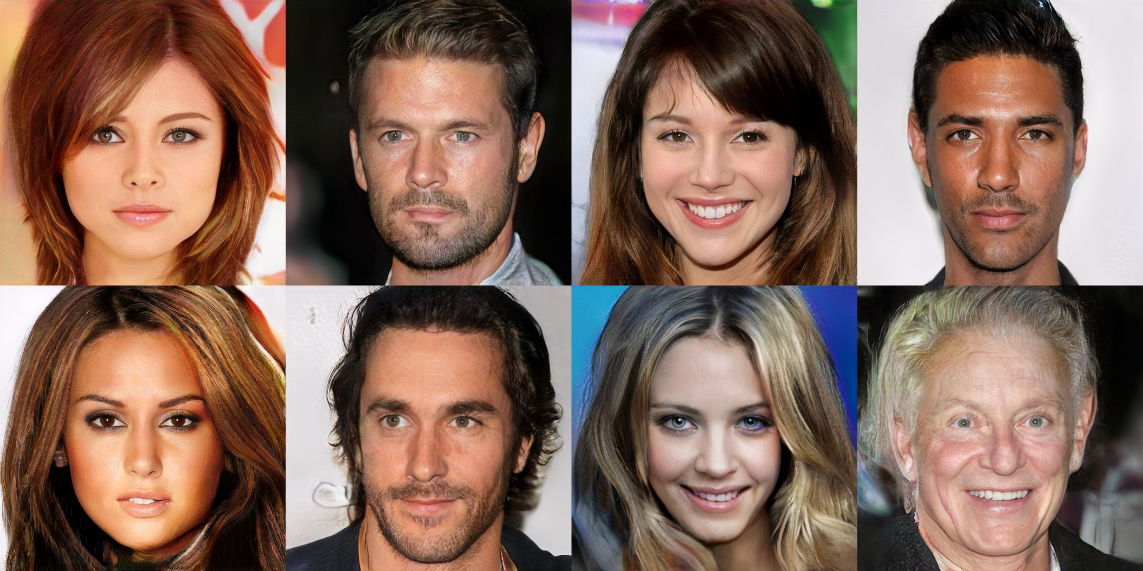

Progressive Growing of GANs for Improved Quality, Stability, and Variation
Karras et al., ICLR’18

Slide 18

All computer generated
Progressive Growing of GANs for Improved Quality, Stability, and Variation
Karras et al., ICLR’18

Slide 19
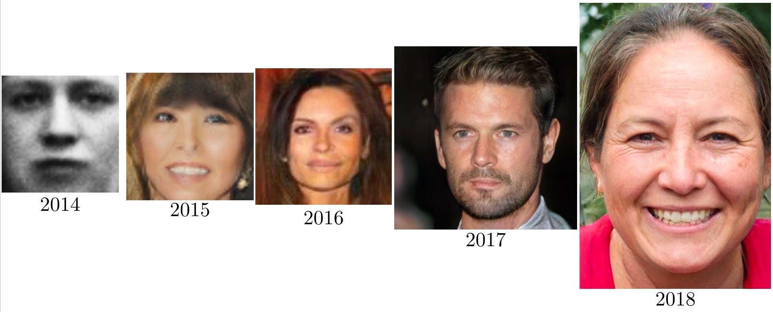
Laurent Charlin — 60629
https://twitter.com/goodfellow_ian/status/1084973596236144640/photo/1

Slide 20
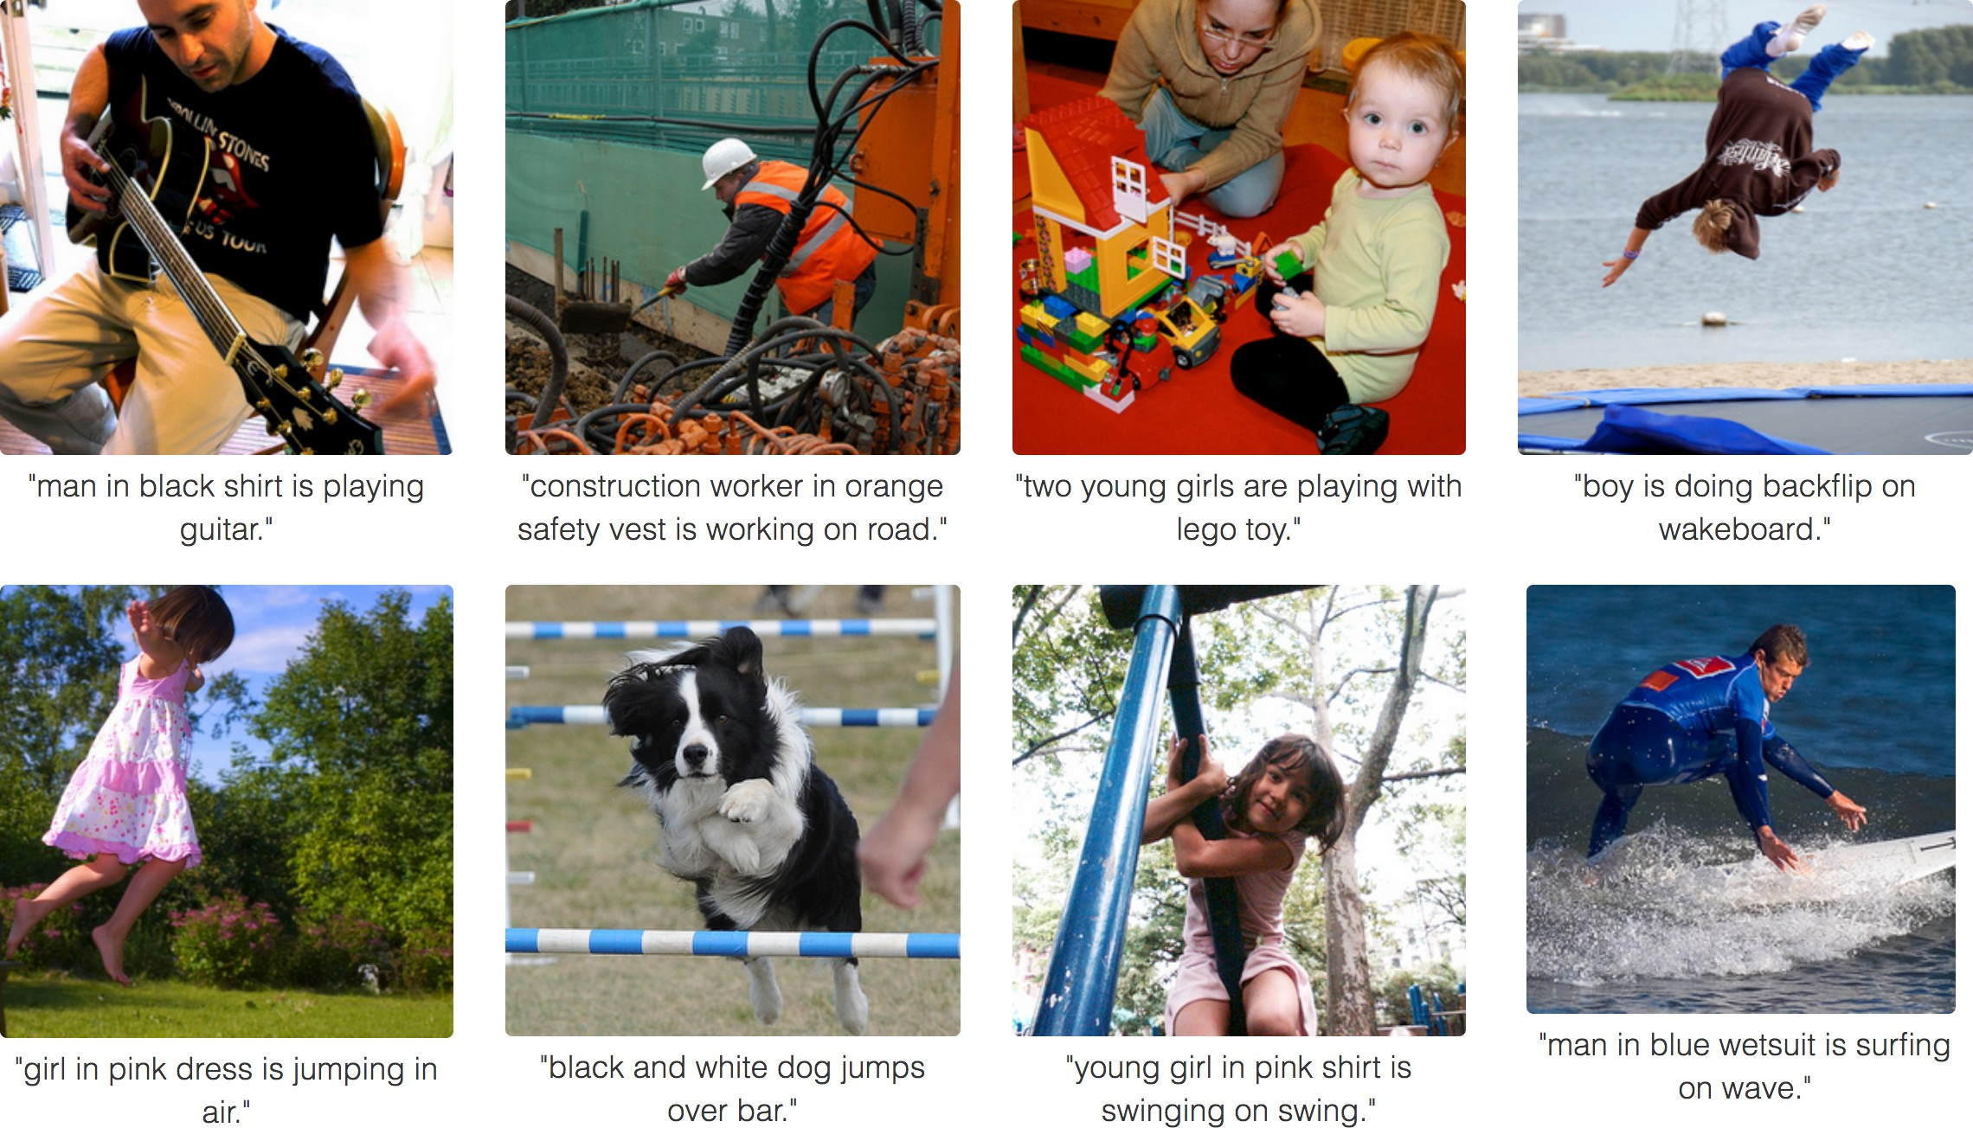
Deep Visual-Semantic Alignments for Generating Image Descriptions
A. Karpathy, L. Fei-Fei, CVPR’15

Slide 21
Deep Visual-Semantic Alignments for Generating Image Descriptions
A. Karpathy, L. Fei-Fei, CVPR’15

Slide 22









Dall-e 2
Stable Diffusion 1.5
https://huggingface.co/spaces/runwayml/stable-diffusion-v1-5
https://openai.com/blog/dall-e/

Slide 23

Generate an image from a text prompt
A bowl of soup that looks like a monster spray-painted on the wall
https://openai.com/dall-e-2/

Slide 24

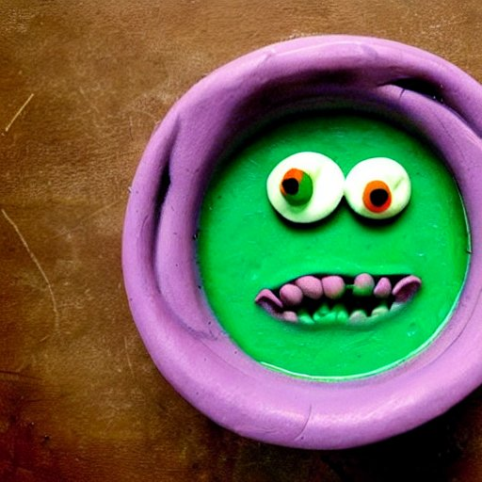
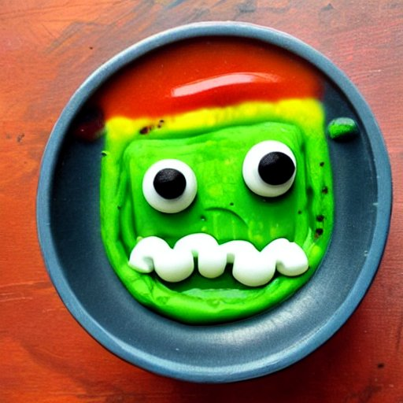

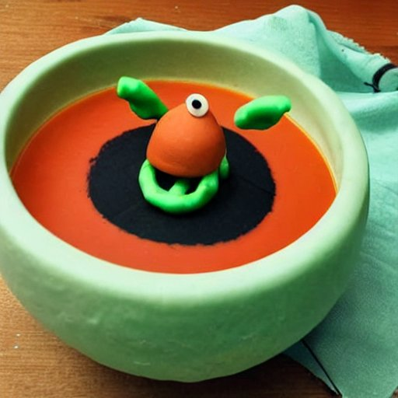
Generate an image from a text prompt
A bowl of soup that looks like a monster made out of plasticine
Stable Diffusion 1.5
https://openai.com/dall-e-2/

Slide 25



Generate an image from a text prompt
Two women shaking hands
https://openai.com/dall-e-2/

Slide 26



Stable Diffusion 1.5
https://openai.com/dall-e-2/

Slide 27
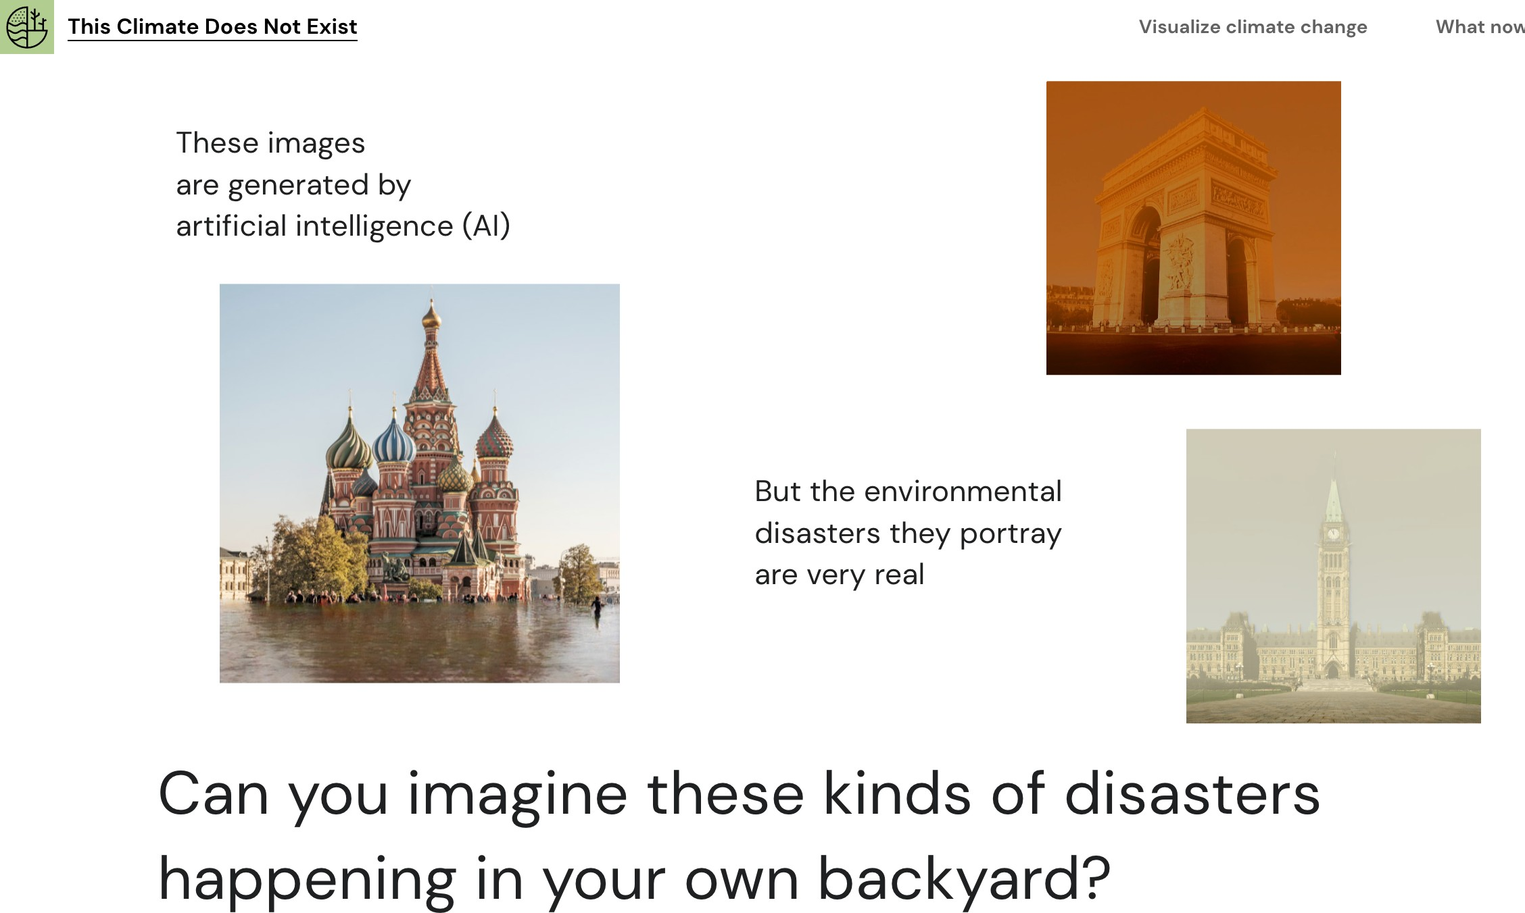
Laurent Charlin — 60629

Slide 28

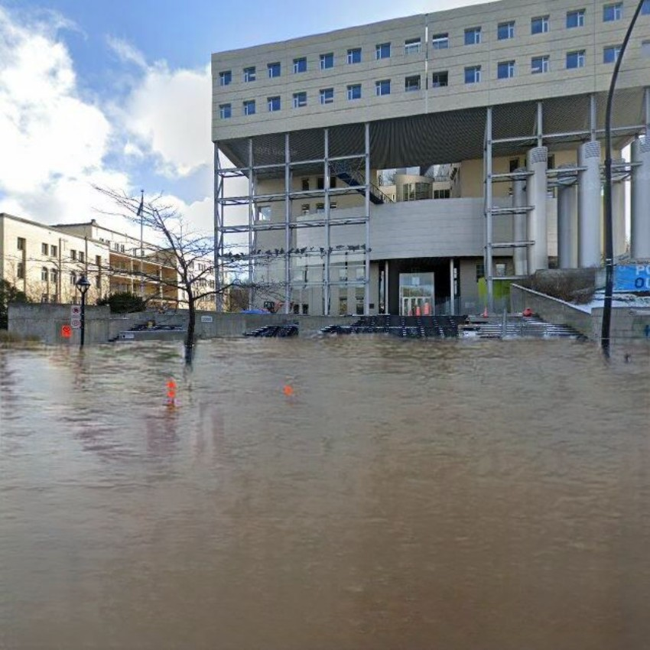
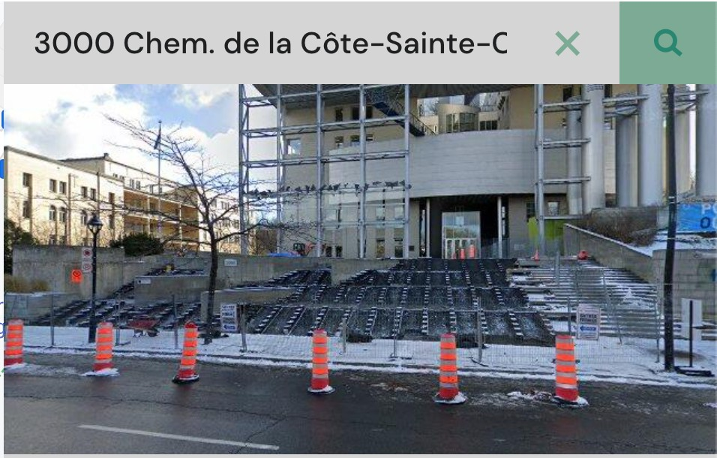
Laurent Charlin — 60629
https://thisclimatedoesnotexist.com/en/share/57d2b713-a6ea-474b-8d32-2012db0f050b

Slide 29
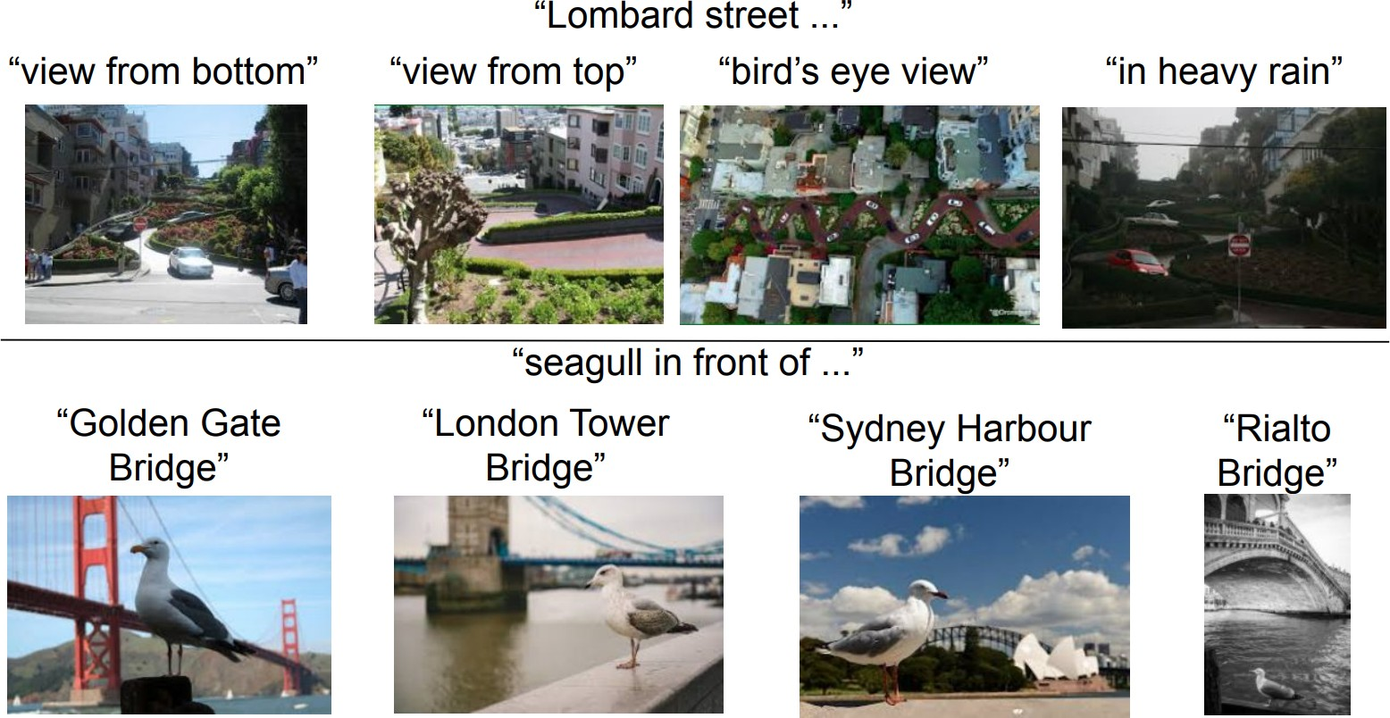
[Jia et al. 21, CoRR: 2102.05918]

Slide 30
[Jia et al. 21, CoRR: 2102.05918]

Slide 31
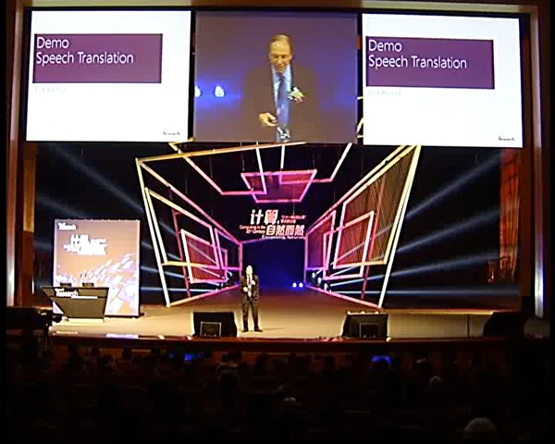

Slide 33
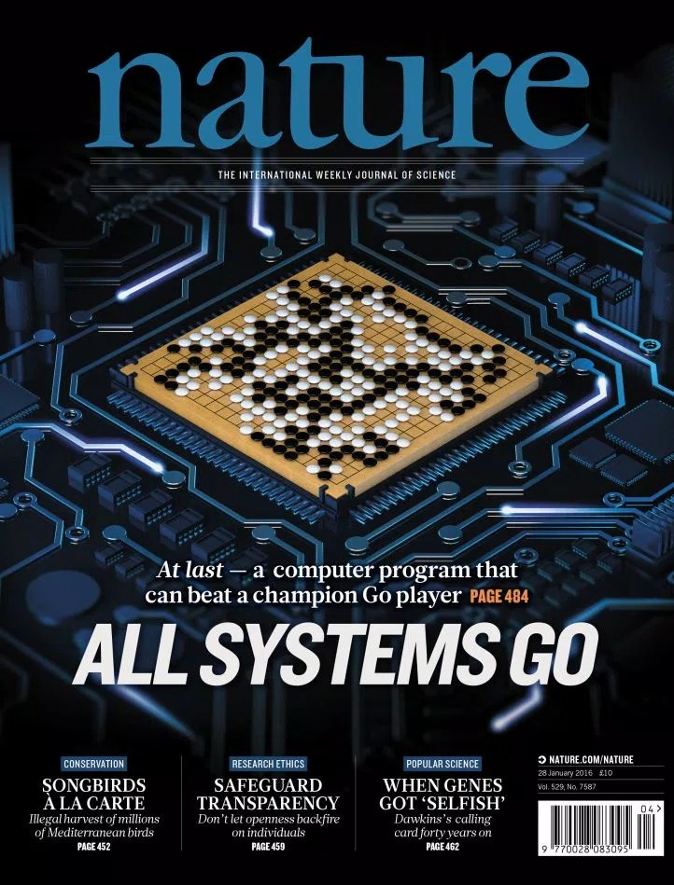
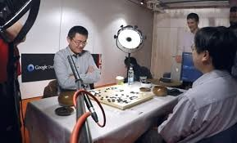

Slide 34


Slide 35


AI for video games
Mnih et al. Nature Volume 518,
pages 529–533
(26 February 2015)

Slide 36


Slide 38
Medicine: personalized, automate diagnostics
Social sciences: prediction problem (e.g., predict recidivism)
Engineering: to propose new design, evaluate without building
Finance: capture uncertainty, short-term trading
Marketing: to understand and quantify user experience, advertising efficacy
Many others: conservation, social projects, climate change
Your domain of expertise…
31

Slide 39
Course Introduction & Goals

Slide 40
Logistics
Course syllabus: https://davoodwadi.github.io/sessions.html

Slide 41
Flipped Classroom
Every week:
Class preparation (Offline):
Weekly material (~90 minutes)
Reading, watching capsules
Class time (Online):
Summary, Q&A, problem solving (120 minutes)

Slide 42
Suggestions for navigating a flipped classroom
In class: Come prepared
Watch the capsules ahead of time
Do the readings
Write down your questions
Capsules: Stay active while watching the capsules (e.g., take notes, pause, go back, think of how it fits in the broader context)

Slide 43
Fit with other courses
HEC
PhD level (originally)
Computationally oriented
Prequel to
Machine Learning II: Deep Learning (MATH 60630A)
Trustworthy Machine Learning (MATH 80630)
Other ML courses in Montreal (U.Montreal, Polytechnique, Mcgill)
More applied (similar to COMP-551@McGill)

Slide 44
Notes on LLMs’ use
Use for learning code
Not for writing code or text

Slide 45
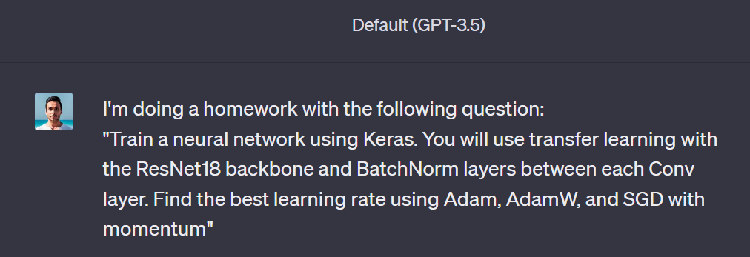
An experiment on ChatGPT

Slide 46
An experiment on ChatGPT
import tensorflow as tf
from tensorflow.keras.applications import ResNet18
from tensorflow.keras.layers import Dense, GlobalAveragePooling2D
from tensorflow.keras.models import Model
from tensorflow.keras.optimizers import Adam, AdamW, SGD
from tensorflow.keras.datasets import ...
# Load your dataset here (e.g., CIFAR-10, ImageNet, etc.)
# (X_train, y_train), (X_test, y_test) = ...

Slide 47
An experiment on ChatGPT
base_model = ResNet18(include_top=False, weights='imagenet', input_shape=(224, 224, 3))
x = base_model.output
x = GlobalAveragePooling2D()(x)
x = Dense(1024, activation='relu')(x)
predictions = Dense(num_classes, activation='softmax')(x) # Adjust num_classes according to your task
model = Model(inputs=base_model.input, outputs=predictions)

Slide 48
An experiment on ChatGPT
# Learning rate finder (optional)
lr_finder = tf.keras.callbacks.LearningRateScheduler(lambda epoch: 1e-8 * 10**(epoch / 20))
# Define learning rates for experimentation
learning_rates = [1e-4, 1e-3, 1e-2, 1e-1]
for lr in learning_rates:
# Adam optimizer
adam_optimizer = Adam(learning_rate=lr)
model.compile(optimizer=adam_optimizer, loss='categorical_crossentropy', metrics=['accuracy'])
model.fit(X_train, y_train, batch_size=32, epochs=5, callbacks=[lr_finder])
# AdamW optimizer
adamw_optimizer = AdamW(learning_rate=lr)
model.compile(optimizer=adamw_optimizer, loss='categorical_crossentropy', metrics=['accuracy'])
model.fit(X_train, y_train, batch_size=32, epochs=5, callbacks=[lr_finder])
# SGD optimizer with momentum
sgd_optimizer = SGD(learning_rate=lr, momentum=0.9)
model.compile(optimizer=sgd_optimizer, loss='categorical_crossentropy', metrics=['accuracy'])
model.fit(X_train, y_train, batch_size=32, epochs=5, callbacks=[lr_finder])

Slide 49
An experiment on ChatGPT
import matplotlib.pyplot as plt
# Plot the learning rate vs. loss graph
lrs = learning_rates
losses = [list_of_adam_losses, list_of_adamw_losses, list_of_sgd_losses] # Update with your actual loss values
plt.semilogx(lrs, losses[0], label='Adam')
plt.semilogx(lrs, losses[1], label='AdamW')
plt.semilogx(lrs, losses[2], label='SGD')
plt.xlabel('Learning Rate')
plt.ylabel('Loss')
plt.legend()
plt.show()
Visible bugs + hidden bugs

Slide 50

An experiment on ChatGPT
Use for learning code
Not for writing code or text

Slide 51
An experiment on ChatGPT
SGD with momentum is an optimization algorithm that builds upon the basic Stochastic Gradient Descent (SGD) method by introducing a momentum term. This momentum term accelerates the optimization process and helps the model overcome the limitations of vanilla SGD, especially in scenarios where the loss surface is rugged or contains many local minima. The achieved lower loss value for SGD with momentum compared to Adam and AdamW could be attributed to several factors:

Slide 52
An experiment on ChatGPT
Acceleration of Convergence: The momentum term in SGD introduces a moving average of past gradients. This has the effect of accelerating the convergence towards the minimum, especially in the presence of oscillations or noisy gradients. This acceleration can help the optimizer escape shallow local minima and make quicker progress towards the optimal solution.
Inertia: The momentum term allows the optimization process to "carry over" some of the direction from previous steps. This inertia helps the optimization process to navigate through flatter regions of the loss surface more efficiently, potentially leading to faster convergence towards a lower loss.
Less Frequent Updates: Adam and AdamW algorithms use more complex mechanisms involving adaptive learning rates and second-moment estimates (RMSprop), which can lead to more frequent updates of the model parameters. In contrast, SGD with momentum can lead to less frequent updates, which may provide the optimization process with a better chance to settle into regions with lower loss values.
Applicability to Data: Depending on the nature of the dataset and the specific task, the way gradients are averaged and the learning rate is adjusted can impact the optimization process. SGD with momentum might be better suited to certain datasets and tasks, allowing it to navigate the loss landscape more effectively.
Hyperparameter Tuning: The performance of optimization algorithms often depends on hyperparameter settings, such as learning rates, momentum values, and batch sizes. It's possible that for this specific task and dataset, the hyperparameters used for SGD with momentum were more suitable and well-tuned, leading to better convergence.

Slide 53
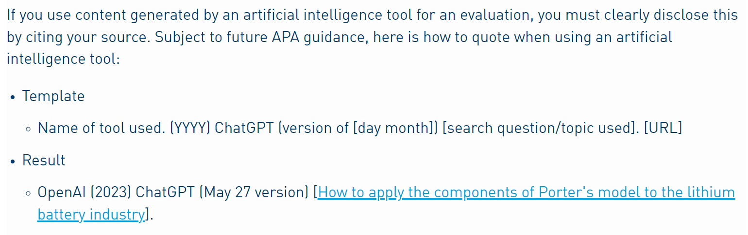
Notes on LLMs’ use
HEC Montreal’s policy on LLMs: https://www.hec.ca/en/integrity/good-practices-and-ressources/index.html#explo-198752-480086

Slide 54

Notes on LLMs’ use
ChatGPT can be detected using plagiarism software
ChatGPT is generally 1. more verbose than a human 2. has a unique identifiable style

Slide 55
Notes on LLMs’ use
ChatGPT can be detected using plagiarism software
ChatGPT is generally 1. more verbose than a human 2. has a unique identifiable style
Dear [Company Name] Hiring Team,
I hope this message finds you well. I am writing to express my strong interest in the Senior Financial Analyst role at [Company Name], as advertised on your website.
With a solid educational background in finance and [X years] of experience in financial analysis and reporting, I am excited about the opportunity to contribute my skills and expertise to your esteemed organization. I have a proven track record of leveraging financial data to drive strategic decision-making, streamline processes, and optimize resource allocation.
From my research into [Company Name]'s reputation for innovation and excellence in the finance industry, I am particularly drawn to your commitment to leveraging data-driven insights to guide financial strategies. I am confident that my proficiency in financial modeling, forecasting, and risk assessment aligns well with the demands of the Senior Financial Analyst role.
I am impressed by [Company Name]'s dedication to fostering a collaborative and dynamic work environment, where professionals are empowered to make meaningful contributions and grow within the company. The opportunity to work alongside a team of experienced financial experts while utilizing cutting-edge tools and technologies greatly appeals to me…

Slide 56
Short review of linear algebra, statistics,
and probabilities

Slide 57
Based on chapters 2 and 3 of “Deep Learning”
http://www.deeplearningbook.org/

Slide 58
Linear algebra
Scalar: a single value.
a E R, a E N
Vector: an array of values.
a R , a N
Matrix: a table of values.
a = 3
₃
D
D
 
a =
4
2
l
3 4 2
1 2 9
A E R^{D1 xD2} , A E N^{D1 xD2}
A =

Slide 59
Indexing notation
Indexing elements of a vector:
a_{i}
Convention:
The first element is the zero’th.
₃
 
a₁
a = 4
2
Indexing elements of a matrix: aij
l
3 4 2
1 2 9
A =
a12

Slide 60
Simple operations
Transpose
a
0
a =
a₁
a₂
a^{T} = a₀ a₁ a₂
(A_{ij})^{T} = A_{ji}
Addition
Vectors and matrices w. the same shape
b
a + b
0
0 0
b = b
a + b = a + b
(A + B)
= A + B
1
1 1
ij
ij
ij
b
a₂ + b₂
2

Slide 61
Simple operations
f
Multiply by a scalar
a a
0
aa =
a a₁
a a₂
Vector product.
The dot product
Note: it yields a scalar.
Element-wise product:
a^{T}a =
_{i} a_{i}a_{i}
I
a a
0 0
a 0 a =
a₁a₁
Also known as Hadamard product
a₂a₂

Slide 62
Operations
Matrix product (dot product):
C_{ij} =
k ^{A}ik^{B}kj
A's columns must equal B’s rows (order is important)
A E R^{D1 xD2} , B E R^{D2 xD3}
Distributive:
Associative:
A(B + C) = AB + AC
A(BC) = (AB)C
Product of transpose: (AB)^{T} = B^{T}A^{T}

Slide 63
Inverse
We denote a matrix’s inverse as
A matrix has an inverse iff:
_{A}-1
it’s square.
D₁ = D₂
A square matrix
not invertible is singular
its columns are linearly independent.
No column can be recovered using a combination of other columns
Inverses are useful to solve systems of equations:
Ax = b x = A⁻¹b

Slide 64
Norms
L^{p}norm. Size of a vector (or matrix)
1/p
I a I_{p}=
Standard norms in ML:
Euclidean norm (p=2)
|a_{i}|
p
i
I a I₂= ^{1�I(�} |a_{i}|²
i
Dot product w. 2-norm:
a^{T}b = ||a||₂||b||₂ cos θ_{ab}
1
{
\
Frobenius norm (matrix):
1
\
L L
}
\ A \ =
|a |
2
2
ij
i j

Slide 65
Special matrices & vectors
1 0 0
I₃ = 0 1 0
0 0 1
Identity. Denoted ^{I}n.
•
All zeros except for ones on the main diagonal.
Symmetric:
Unit vector:
A = A^{T}
a/1₂ = 1
Orthogonal vectors: a^{T}b = 0
Orthonormal vectors: unit and orthogonal
A^{T}A = AA^{T} = I
Orthogonal matrix: Orthonormal rows & columns

Slide 66
Skip eigendecomposition, SVD, pseudo-Inverse, determinants (Sections 2.7–2.11).
We will get back to them if/when needed in the course.

Slide 67
On to probabilities
Chapter 3 of “Deep Learning”
I’ve adapted some of the lecture slides from the book.
Thanks to Ian Goodfellow for providing slides.

Slide 68
Why probabilities?
To capture uncertainty
E.g., What time will I get home tonight?
Probabilities provide a formalism for making statements about “data generating processes” (L. Wasserman)
E.g., what happens when I flip a fair coin?
Probability
Data generating process
Observed data
Inference

Slide 69
The example
Generate data by throwing a fair die.
What do we know about a single throw?
6 possible outcomes. (sample space)
Each outcome (e.g., 1). (element, state)
A subset of outcomes (e.g., <3). (event)
Outcomes are equiprobable. (uniform distribution)

Slide 70
Random variables and probabilities
A random variable (r.v.) is a probabilistic outcome.
For example,
Die throw (X)
The actual outcome is E {1, 2, 3, 4, 5, 6}. (x)
A probability function (P) assigns a real number to each possible event: P(x) 2 0, Vx E X
P x = 1

Slide 71
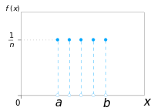
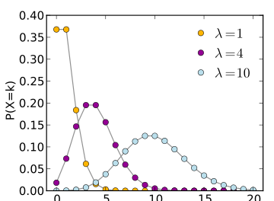
Discrete RVs
An RV is discrete if it takes a finite number of values¹
P(x = x_{i}) � 0, \ii
P(x = x_{i})
P(x = x_{i}) = 1
1
k
i
E.g., uniform distribution:
1
P(x = x ) =
, Vi
i
k
E.g., Poisson distribution:
P(x = x_{i}; ,\) =
,\^{xi} exp^{-,\}
x_{i}!
1. technically: it must be countable
both images are
from: wikipedia.org
Laurent Charlin — 60629
52

Slide 72
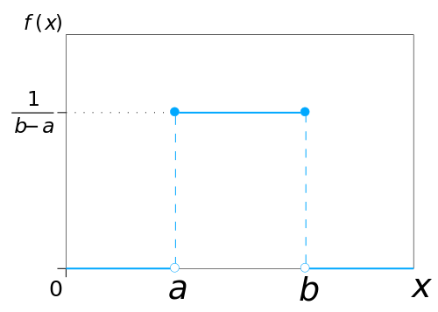
Continuous RVs
An RV is continuous if f(x) � 0, Vx E X
r
oo
f(x)dx = 1
-oo
P(a < x < b) = f(x)dx
r
b
a
f(x) is a probability density function (PDF)
E.g., (continuous) uniform distribution:
(
if x 2 [a, b]
0 otherwise
1
u(x; a, b) =
b-a
E.g., Gaussian distribution
from: wikipedia.org

Slide 73
A few useful properties
(shown for discrete variables for simplicity)
Sum rule:
Product rule:
n
Chain rule: P(X_{l}, . . . , X_{n}) = ^{rr} P(X_{i} | X_{l}, . . . , X_{i−l})P(X_{l})
i=l
If x and y are independent:
Bayes’ Rule:

Slide 74
Moments
Expectation:
Variance:
Covariance:
L
E[X] = P(x = x )x
E[aX] = aE[X]
i i
i
o-² = E[(X - E[X])²]
Cov(X, Y) = E (X - E[X])(Y - E[Y])
Cov(X, Y)
correlation: p(x, y) =
<J_{x}<J_{y}

Slide 75
Further Reading
Prologue to “The Master Algorithm”
http://homes.cs.washington.edu/~pedrod/Prologue.pdf
Ch. 1 of Hastie et al.
Math Preparation
Ch.2 of Pattern Recognition and Machine Learning [PRML]
Ch.2-3 of Deep Learning [DL]
Slightly more advanced:
http://www.cs.mcgill.ca/~dprecup/courses/ML/Materials/prob-review.pdf http://www.cs.mcgill.ca/~dprecup/courses/ML/Materials/linalg-review.pdf

